Slide 1
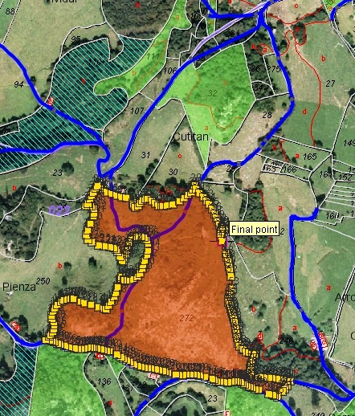
A Gentle introduction to GIS
CHAPTER 1
Principles of Geographic Information Systems
An introductory textbook

Slide 2
Nature of GIS
GIS – Geographic Information System
Tool for working with geographic information
Applications:- used by urban planner, biologist, natural hazard analyst, geological engineer, mining engineer, geoinformatics engineer, forest manager etc
Professionals work with positional data(relative to earth’s surface) – spatial data (where things are)
Challenge in GIS – “spatio-temporal problem”
The object of study has different characteristics for different locations (spatial/geographic dimension) and these characteristics change over time (temporal dimension)
Sudha Bhagavatheeswaran, Department of Information Technology,
SIES College of Arts, Science & Commerce (Autonomous)

Slide 3
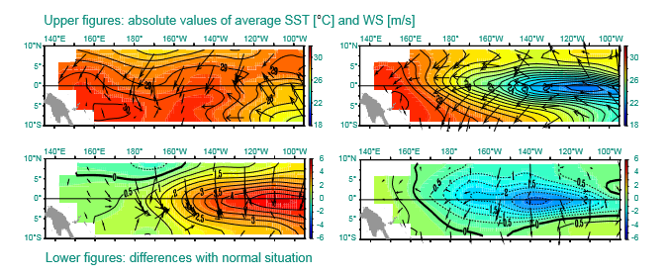
Example
El Nino – “little boy” –is an aberrant pattern in weather and sea water temperature(every 4-9 years) in Pacific Ocean along equator.
Makes weather hotter, has impact on global weather systems, comes around Christmas
La Nina – “little girl” – pattern of colder temperature that occurs less frequently.
Figure marked 1 & 2 – El Nino that occurred in the year 1997
Figure marked 3 & 4 – La Nina that occurred in the year 1998
SST – Sea Surface Temperature (ºC) & WS – Average wind speed (m/s)
1997
1998
1
3
2
4

Slide 4

Defining GIS
Computer based system
Produces four sets of capabilities to handle georeferenced data:-
  Data Capture and preparation
  Data management; storage and maintenance
  Data manipulation and analysis
  Data presentation
GISystems, GIScience, GIS Applications
Sudha Bhagavatheeswaran, Department of Information Technology,
SIES College of Arts, Science & Commerce (Autonomous)

Slide 5
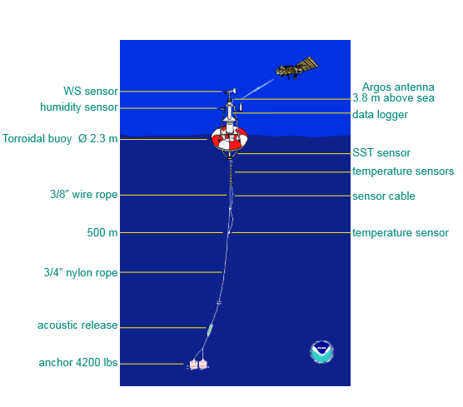
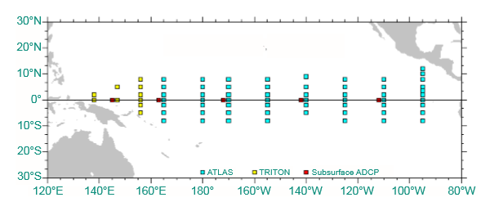
Data Capture
Collection of Sea Surface Temperature and wind speed measurements.
This is achieved by placing buoys with measuring equipments at various places in the ocean. ( buoy - an anchored float serving as a navigation mark)
70 buoys. A buoy measures:- i) wind speed & direction ii) air temperature & humidity iii) sea water temperature at surface and depth upto 500 m.
Sudha Bhagavatheeswaran, Department of Information Technology,
SIES College of Arts, Science & Commerce (Autonomous)

Slide 6
Data Management
Storage and maintenance of data transmitted by the buoys via satellites
01
Transfer data in digital form to begin analysis
02
Decision on how best to present data (in terms of spatial properties and various attributes)
03
Sudha Bhagavatheeswaran, Department of Information Technology,
SIES College of Arts, Science & Commerce (Autonomous)

Slide 7
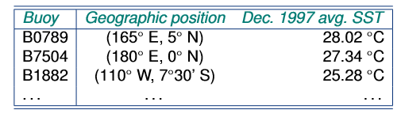
Data Manipulation and Analysis
For each buoy, average SST for each month calculated using daily SST measurements.
For each buoy, monthly average SST was taken with geographic location to obtain georeferenced list of averages.
From this georeferenced list, through a method of spatial interpolation, the estimated SST of other positions were computed. (Table below)
Previous to the above steps, we obtained data about average SST for December for a series of years. This is spatially interpolated to obtain a normal situation for December data set.
GIS function: deriving an estimate value for a property for some location where we have not measured
Georeferenced: associated with some position on Earth’s surface by using spatial reference system (latitude longitude co-ordinate system)
A statistical method of deriving a simple function from the given discrete data set such that the function passes through the provided data points is called interpolation.
Sudha Bhagavatheeswaran, Department of Information Technology,
SIES College of Arts, Science & Commerce (Autonomous)

Slide 8
Data Presentation
Message:- What message to portray? – to explain what is el nino and la nina events.
Audience:- Who is the audience? – students, people in general, analysts
Medium – What form to present it? – paper, book – formats, size
Rules of aesthetics – How will it look? – north –up, clear georeferencing, use of symbols etc.
Techniques – color scheme, isolines etc.
Sudha Bhagavatheeswaran, Department of Information Technology,
SIES College of Arts, Science & Commerce (Autonomous)

Slide 9
Spatial Data and Geoinformation
Data
Spatial Data – Data with positional values
Geospatial data - Spatial data that is georeferenced.
Spatial data – synonymn - Georeferenced data
Geoinformation – information resulting from interpretation of spatial data
Components of spatial data
  Positional accuracy(horizontal and vertical)
  Temporal accuracy(data up to date)
  Attribute accuracy(labelling of features)
  Lineage(history of data including sources)
  Completeness(data set represents all related features of reality)
  Logical consistency(data is logically structured)
Sudha Bhagavatheeswaran, Department of Information Technology,
SIES College of Arts, Science & Commerce (Autonomous)

Slide 10
Modelling
Representation of a part of the world.
Make decisions effectively, predict
Helps us answer ‘what-if’ questions
Change/alter parameters of the model to investigate the changes.
‘Real world model’- representation of a number of phenomena that we can observe in reality, to enable some type of study, administration, computation or simulation.
Maps – paper model
Databases – digital model
Both are static models
Process models are dynamic (emphasise changes)
Sudha Bhagavatheeswaran, Department of Information Technology,
SIES College of Arts, Science & Commerce (Autonomous)

Slide 11
Maps
Best known conventional model
Is a graphical representation at certain level of detail determined by scale
Disadvantage:- restricted to 2D static representation and display in a fixed scale.
Map scale determines the spatial resolution of graphic feature representation.
Smaller the scale, less detail a map can show.
Selection of a proper scale is important.
Have physical boundaries and is the data source for other applications.
Cartography – Art and Science of map making, interpreter that translates real world phenomena into correct clear understandable representations for our use.
Digital Cartography with the advent of computers.
Sudha Bhagavatheeswaran, Department of Information Technology,
SIES College of Arts, Science & Commerce (Autonomous)

Slide 12
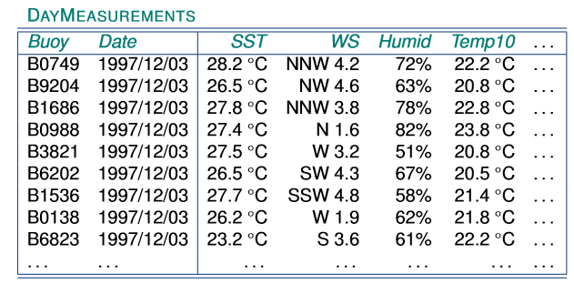
Databases
Repository for storing large amounts of data.
Concurrent use, data integrity – rules on stored data
Number of techniques to store data(storage optimization)
Easy to use DML – query facility
Each query executed in the most efficient way – query optimization
Spatial databases – to store spatial data
Representation in a spatial database may have a point, line, area or image characteristics.
Sudha Bhagavatheeswaran, Department of Information Technology,
SIES College of Arts, Science & Commerce (Autonomous)

